Slide 1
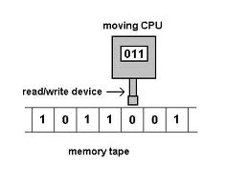
Variants of Turing Machines
Course Instructor: Dr Sohail Iqbal

Slide 2
Recap:
Turing’s thesis:
Any computation carried out
by mechanical means
can be performed by a Turing Machine

Slide 3
Note:
There is one Standard Turing Machine (that we studied)
Due to hardware limitations, we can always modify the standard machine
Such modified machine is called a “Variant of Turing Machine”

Slide 4
The Standard Model
Infinite Tape
Read-Write Head
(Left or Right)
Control Unit
Deterministic

Slide 5
Variations of the Standard Model
Turing machines with:
Stay-Option
Semi-Infinite Tape
Off-Line
Multitape
Multidimensional
Nondeterministic
Different Turing Machine Classes

Slide 6
Same Power of two machine classes:
both classes accept the
same set of languages
We will prove:
each new class has the same power
with Standard Turing Machine
(accept Turing-Recognizable Languages)

Slide 7
Same Power of two classes means:
for any machine of first class
there is a machine of second class
such that:
and vice-versa

Slide 8
Simulation:
A technique to prove same power.
Simulate the machine of one class
with a machine of the other class
Second Class
Simulation Machine
First Class
Original Machine
simulates

Slide 9
Configurations in the Original Machine
have corresponding configurations
in the Simulation Machine
Original Machine:
Simulation Machine:

Slide 10
Accepting Configuration
Original Machine:
Simulation Machine:
the Simulation Machine
and the Original Machine
accept the same strings

Slide 11
Turing Machines with Stay-Option
The head can stay in the same position
Left, Right, Stay
L,R,S: possible head moves

Slide 12
Example:
Time 1
Time 2

Slide 13
Theorem:
Stay-Option machines
have the same power with
Standard Turing machines
Proof:
1. Stay-Option Machines
simulate Standard Turing machines
2.
Standard Turing machines
simulate Stay-Option machines

Slide 14
1. Stay-Option Machines
simulate Standard Turing machines
Trivial: If out of move options of L, R, S;
we use only L & R; we are done.

Slide 15
2.
Standard Turing machines
simulate Stay-Option machines
We need to simulate the stay head option
with two head moves, one left and one right

Slide 16
Stay-Option Machine
Simulation in Standard Machine
For every possible tape symbol

Slide 17
For other transitions nothing changes
Stay-Option Machine
Simulation in Standard Machine
Similar for Right moves

Slide 18
example of simulation
Stay-Option Machine:
1
2
Simulation in Standard Machine:
1
2
3
END OF PROOF
Notes:
The Simulator tries to duplicate the behavior of the device. The Emulator tries to duplicate the inner workings of the device.

Slide 19

What if you see the potential somewhere for future computing?

Slide 20

It is sufficient to show that model of your technology is a variant of a standard Turing Machine
You can perform any computing on it !

Slide 21
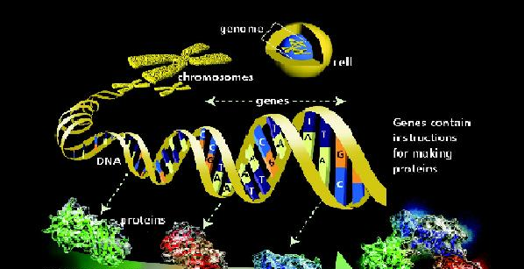
EMBO reports 4, 1, 7–10 (2003)
doi:10.1038/sj.embor.embor719
Computing with DNA
Although DNA clearly outclasses any silicon-based computer when it comes to information storage and processing speed, a DNA-based PC is still a long way off (Jack Parker)

Slide 22
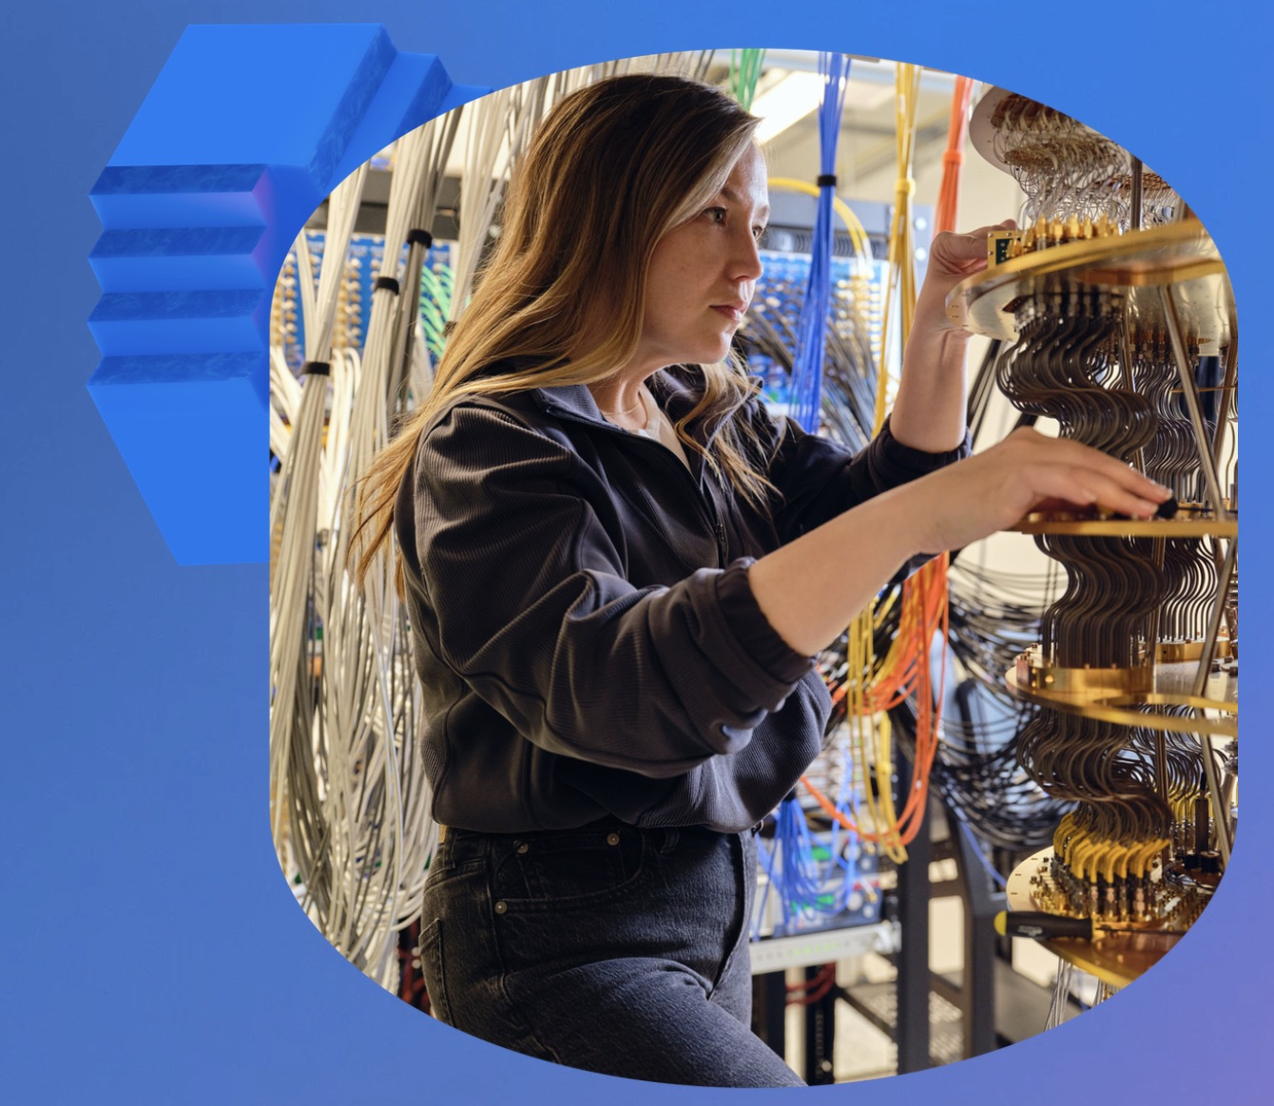
Google’s Quantum Computer

Slide 23

Computing Hardware Evolves:
Computing HW are based on:
Gears
2. Relays
3. Valves
4. Integrated Chips
5. Silicon wafers
6. Quantum Registers
7. DNA registers

Slide 24
Read Section 3.2 from the Siper’s book
Thank You!

